Slide 1
Autonomous Accident Management System
We deliver safer and better emergency transport.

Slide 2

Mission statement: Our mission is to make your life safer.

Slide 3
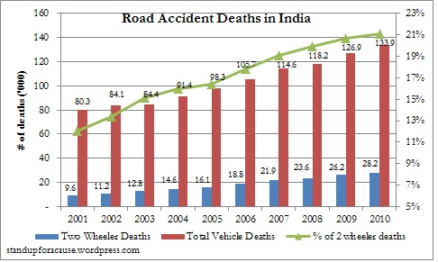
The problem
Taking today’s scenario, We see that whenever an accident happens in India ambulance is called and then when the ambulance is on it’s way it faces many blockages and traffic leading to delay in treatment of the patient and sometimes it could also cost patient’s life.

Slide 4

The solution
Autonomous Accident Management System
Faster
Effective
Efficient
Life Saving

Slide 5


The team
We deliver better
Gauransh Kumar
Satyam Mishra
The programming and technical support.
The ideation and business model support.

Slide 6
Milestones
The already done and upcoming milestones of the product.
January 2020
May 2020
February 2020
July 2020
Creation of the base - calling and working with APIs
Adding new ML algorithms to give the patient some treatment
Jan | Feb | Mar | Apr | May | Jun | Jul | Aug | Sept | Oct | Nov | Dec
Making the system more advanced with integration in Ambulances
Making the services more good day by day

Slide 7
How it works
Step 3
Step 2
Step 1
Making the treatment more easy and advanced while in the van only
Finding the shortest route and to the patient and back to hospital
Tracking the targeted coordinates

Slide 8

The technology:
HERE Routing + Maps API

Slide 9

Revenue model
Currently, we are looking to generate revenue from our product by teaming up with HERE technologies to create such inbuilt GPS systems in ambulances and advancing the ambulances for test runs.

Slide 10

Why now?
As the world is getting advanced and autonomous that’s why for the advanced world we must have a autonomous accident management system.

Slide 11
Q&A
If you have any doubt feel free to ask us.

Slide 12
Thank You for being such a good audience.

